Slide 1
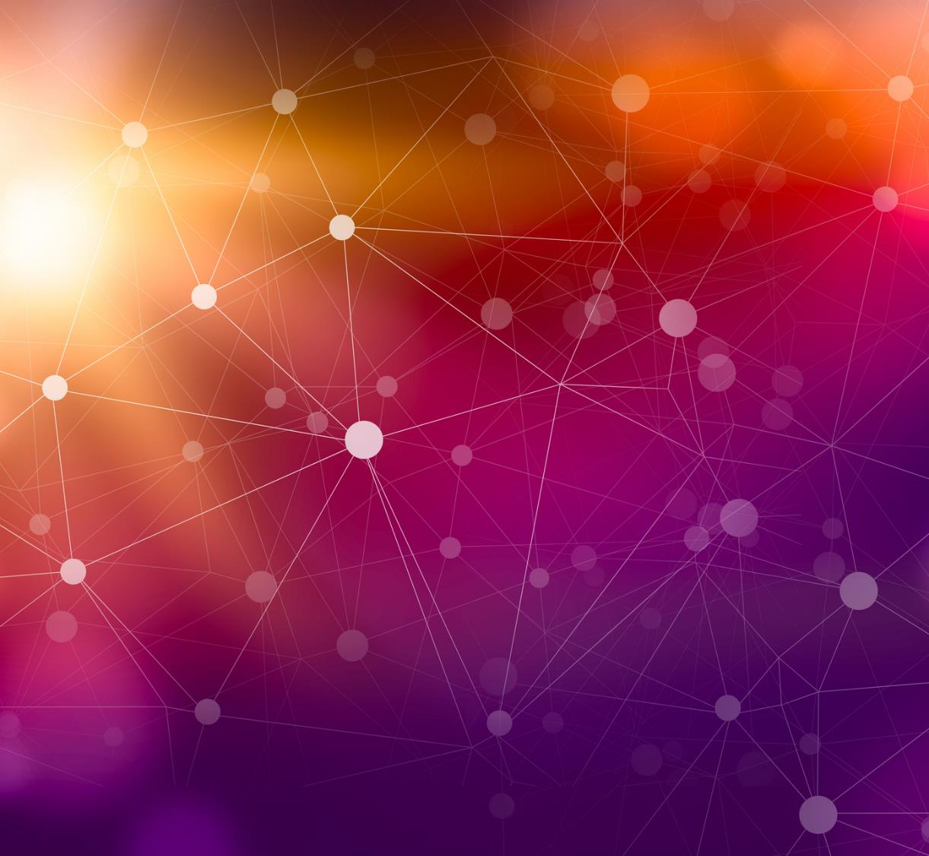
Digital Communication: Security in 6G SAGIN
Sangeen Khan: M202261028
Vandeane Smith: M202261029

Slide 2



Agenda
Introduction
Why do we need 6G?
The benefits of 6G
The need for security in 6G
Security threats in 6G SAGIN

Slide 3
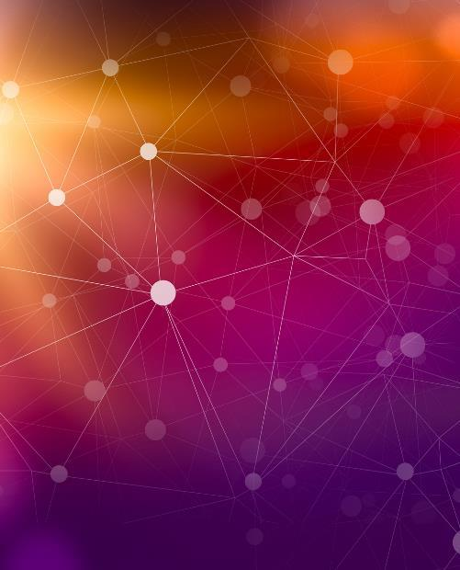
Introduction
A crucial global technological demand has emerged due to the exponential development in the numbers of smart devices and the network traffic available today. Future-oriented use cases including smart mobility, remote connectivity, marine surveillance, interstellar communication, smart cities, and disaster relief must make use of sophisticated networking services. Terrestrial networks alone cannot effectively address the massive traffic problems caused by these overbearing service awareness demands. In order to facilitate delay-mitigating network services, it is anticipated that terrestrial networks, together with the space and aerial communication infrastructures, would function together.

Slide 4

Why do we need 6G?
~ Because it is better than 5G.

Slide 5
Benefits of 6G
The peak data rate proposed for 5G is 20Gb/s while the peak wireless data rate of 6G will be about 100 Gb/s.
The 5G latency rate of 1 millisecond will be further reduced by 6G to microseconds.
6G Device density and IoT connectivity will be much denser than 5G.
Security is expected to be much better in 6G when compared to 5G.
Quantum communication and cryptography are expected to be deployed in 6G.
6G SAGIN will be able to establish reliable communication in desserts and unconnected territories.

Slide 6
The need for security in 6G

Slide 7
The need for security in 6G
As an important subsystem of 6G network, satellite communication, SAGIN, has received widespread attention. The satellite Internet is characterized by exposed nodes, open channels, and highly dynamic topology, which makes the link vulnerable to malicious electromagnetic signals, atmospheric electromagnetic signals and cosmic interferences. Moreover, the communication signals are easy to be eavesdropped and intercepted illegally by malicious users. The solutions to these shortcomings are in the development of wireless secure transmission, identity authentication and communication anti-jamming methods of satellite internet.

Slide 8

1. Threat of eavesdropping 2. Threat of forgery 3. Threat of communication interference
Security threats in 6G SAGIN

Slide 9
Threat of eavesdropping: Satellite Internet communication has the characteristics of long transmission distance, slow communication rate, and dense satellite clusters, which makes the communication between satellites more likely to be eavesdropped by the enemy.
Security threats in 6G SAGIN

Slide 10
Threat of forgery: At present, the control commands in satellite communication are sent by plaintext commands or only simple encrypted transmissions. It is easy for the enemy to forge fake control commands to send commands to the satellite, causing the legal communication of the satellite to be interrupted and normal.
Security threats in 6G SAGIN

Slide 11
Threat of communication interference: The electromagnetic environment of the satellite Internet is complex, and it is extremely susceptible to electromagnetic interference from malicious signals, electromagnetic signals in the atmosphere, and various interferences such as cosmic rays, which affect the data transmission of normal satellite communications or even interrupt.
Security threats in 6G SAGIN

Slide 12

Summary
Due to the lack of security standards and adequate protection capabilities of satellite
Internet, security problems may occur at any time. From stealing privacy to satellite control, adversaries can easily shut down satellites and deny service, in addition to jamming or spoofing satellite signals and even gaining complete control over satellites. Therefore, it is imperative to study the security and anti-jamming technology of satellite Internet communication.

Slide 13

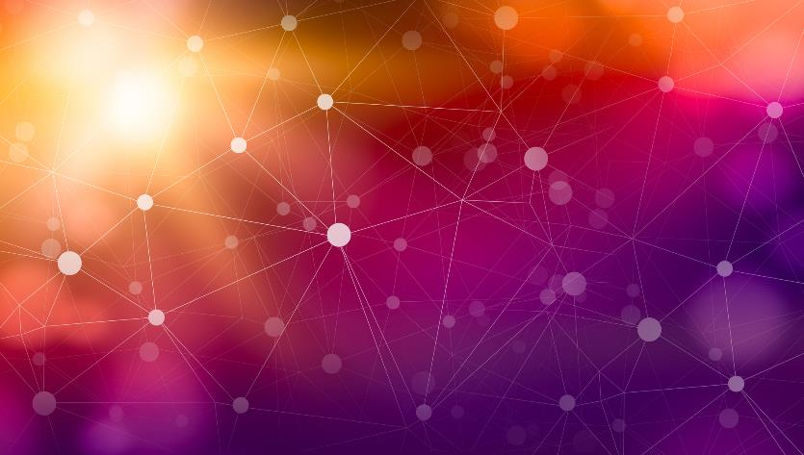
Thank You
谢谢

